Slide 1

Find out why Koha is chosen by everyone from National Libraries, large public consortia, to the tiniest community libraries.
Hint: maybe it's not 5 year contracts.

Slide 2
INTRODUCTIONS
Kathryn Tyree Project Manager
@kathrynpipesup
Chris Cormack Software Developer
@ranginui

Slide 3

ABOUT CATALYST

Slide 4
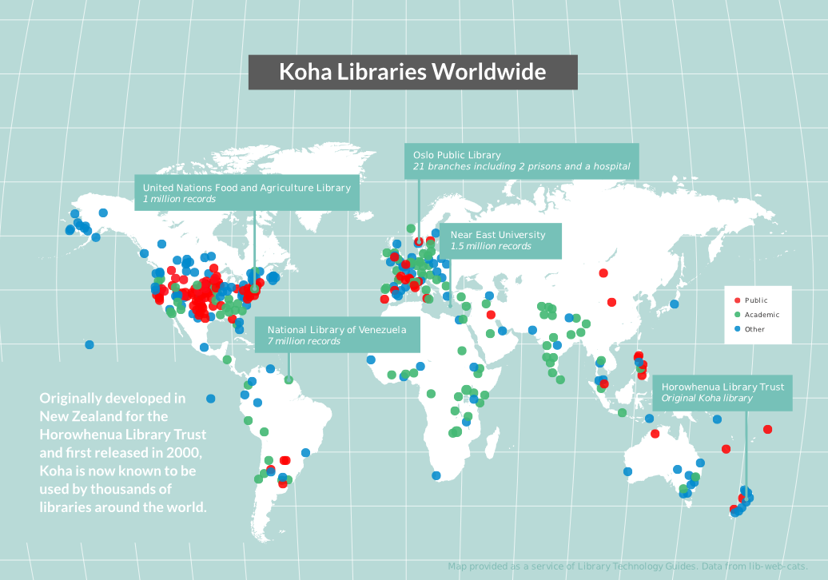

Slide 5
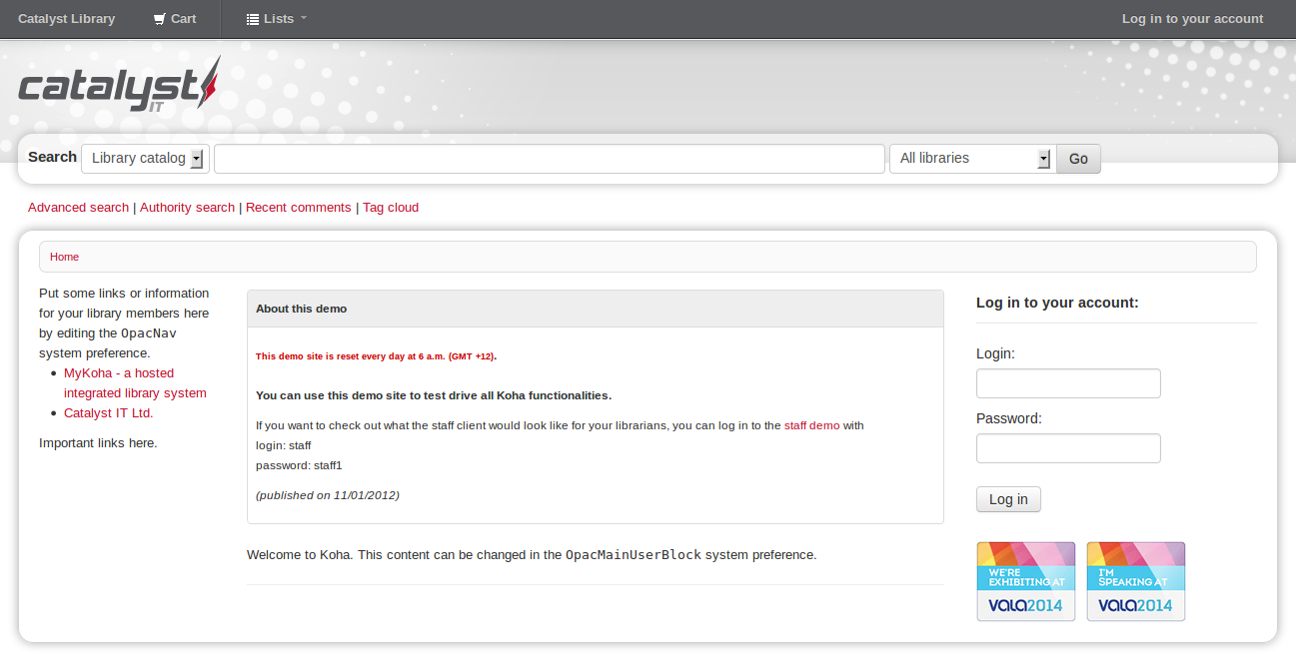
OPAC/PUBLIC INTERFACE

Slide 6
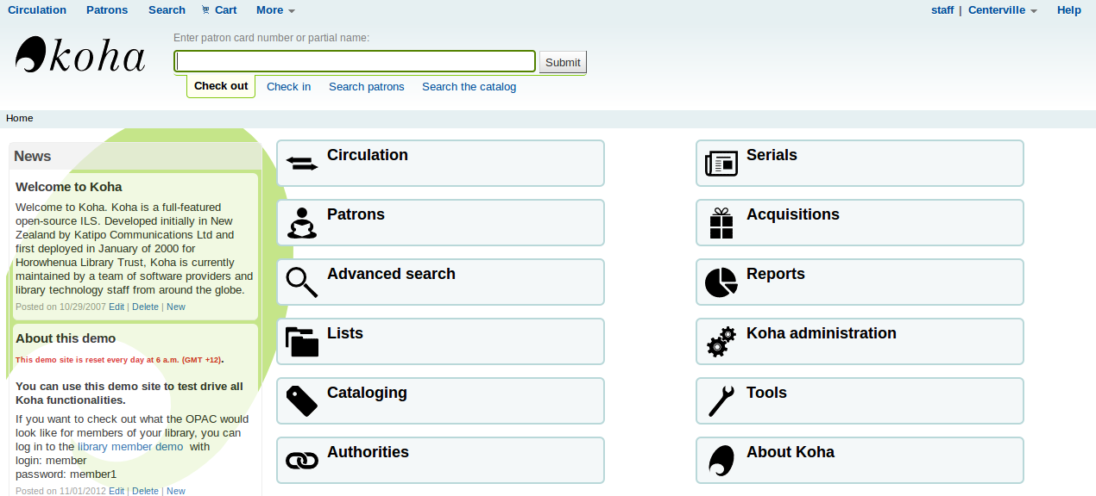
STAFF INTERFACE

Slide 7

OPEN SOURCE

Slide 8

koha-community.org

Slide 9
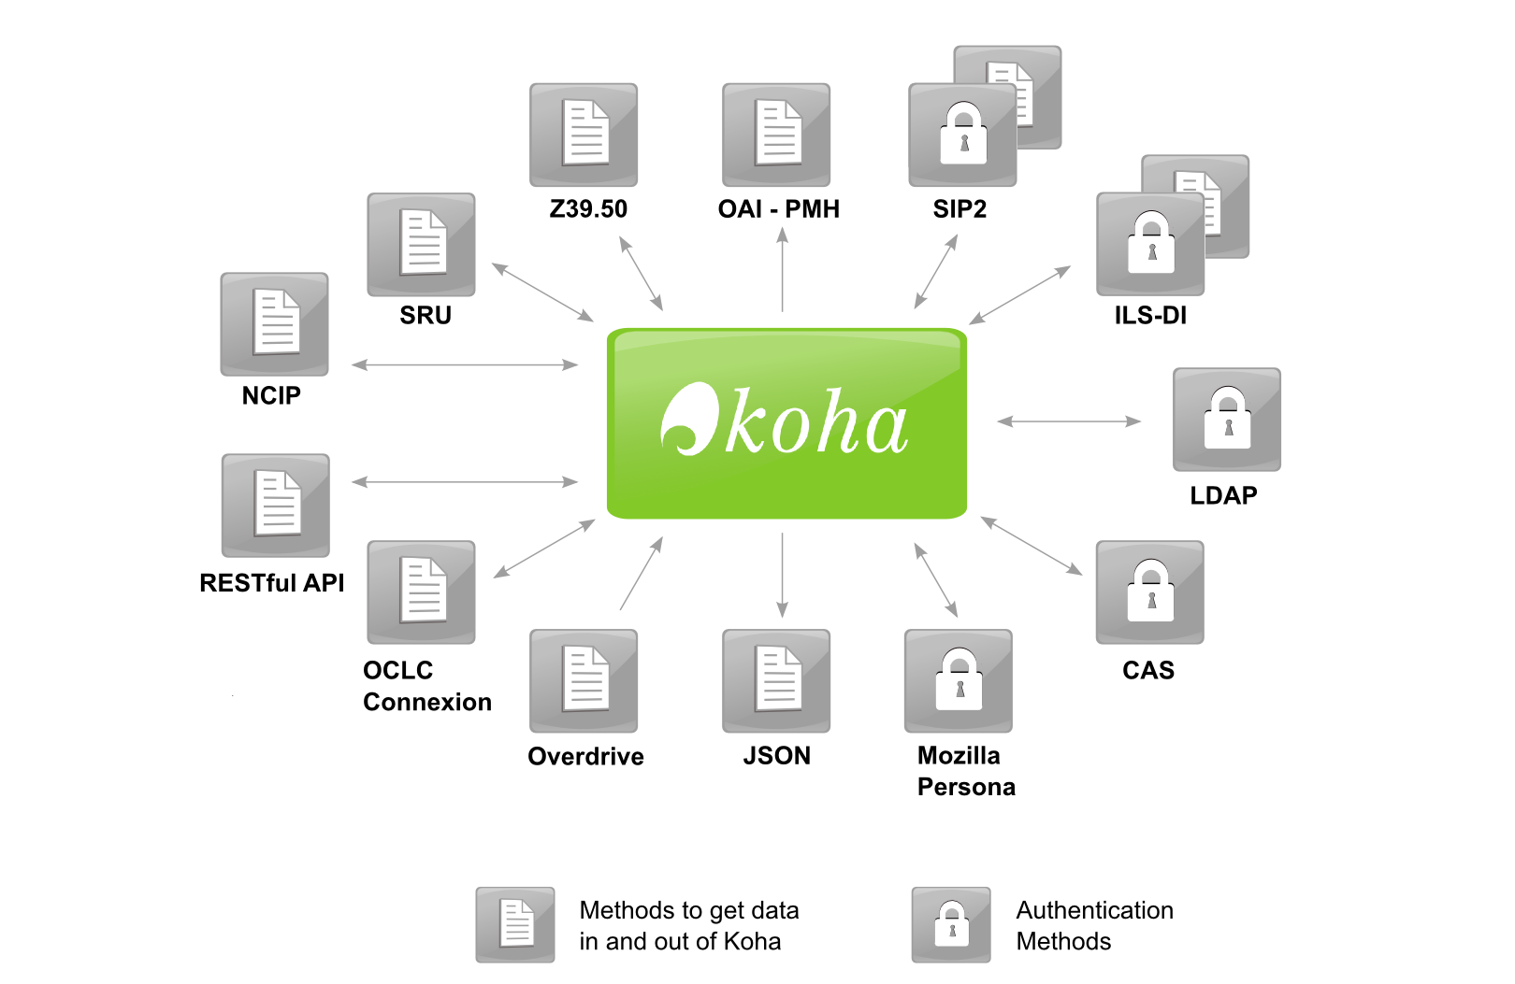
OPEN INTEGRATION (IT'S A PLATFORM)

Slide 10
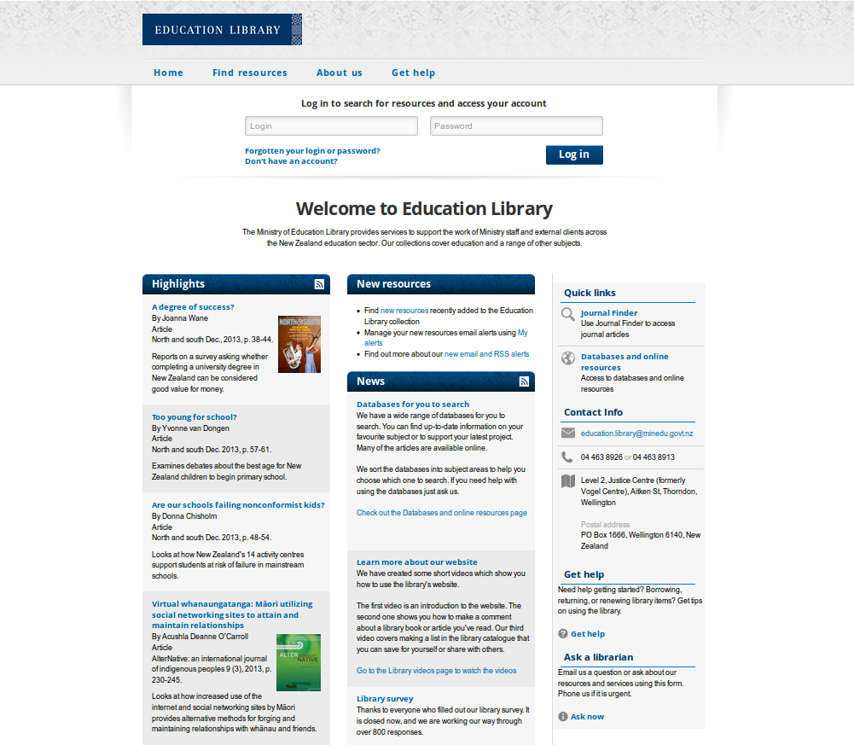
INTEGRATION EXAMPLES – e.g. WITH A WEBSITE

Slide 11
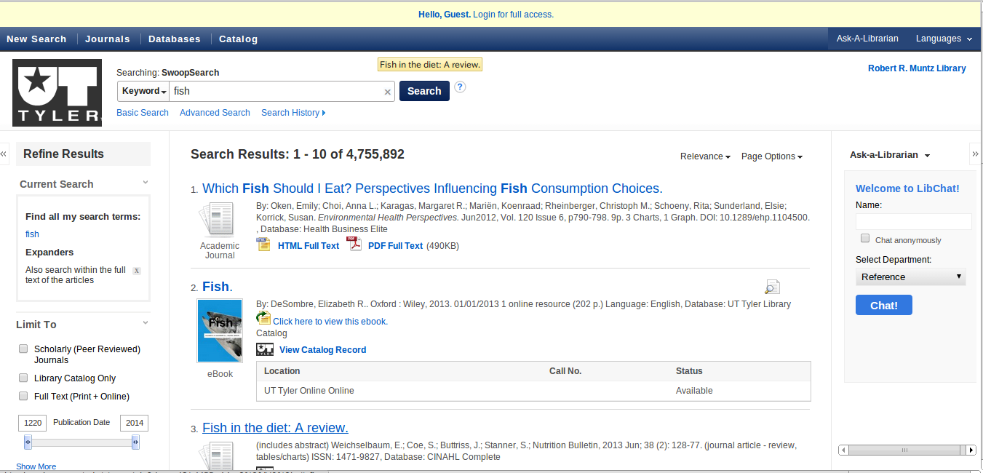
WITH 3RD PARTY CONTENT PROVIDERS

Slide 12
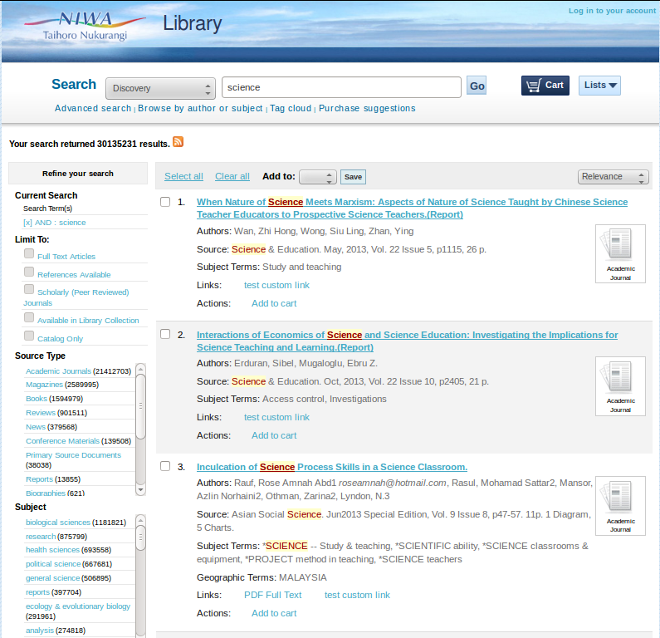
KOHA AS INTEGRATED SEARCH INTERFACE 1/2

Slide 13
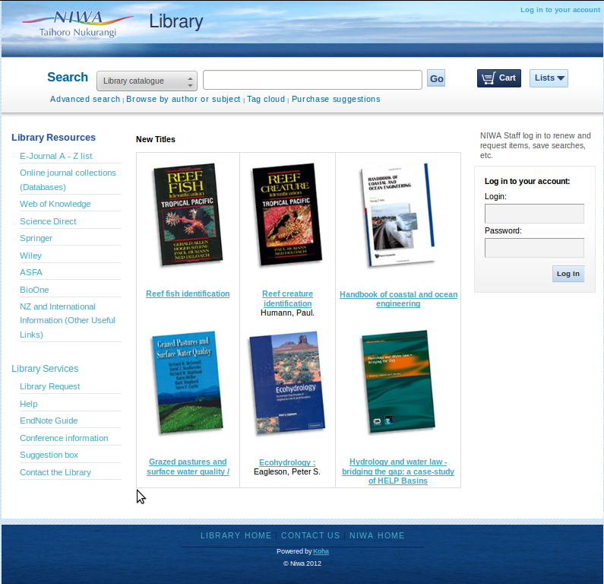

Slide 14
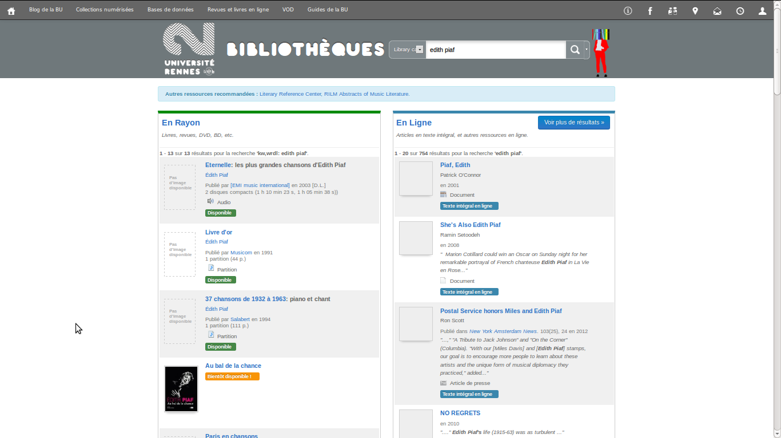
KOHA AS INTEGRATED SEARCH INTERFACE 2/2

Slide 15
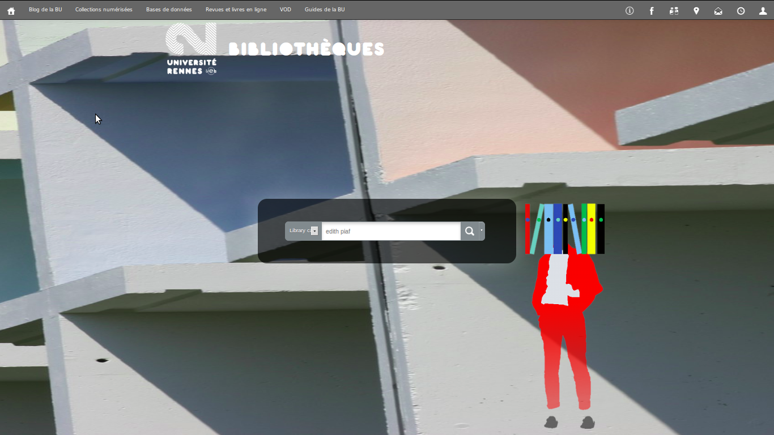
MAKE KOHA LOOK HOWEVER YOU WANT

Slide 16
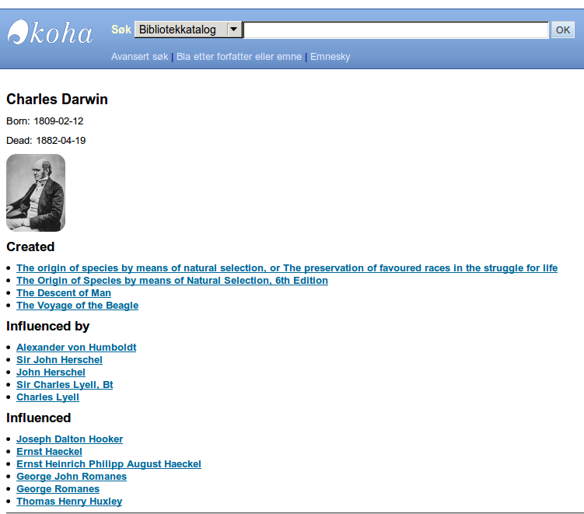
LINKED DATA

Slide 17
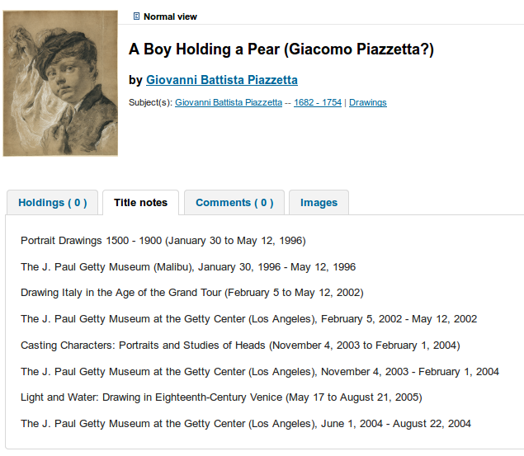
LINKED DATA cont.

Slide 18
QUESTIONS?
Go ahead, ask us something...

Slide 19
TALK TO YOU LATER
We're at stand #11
Kathryn Tyree @kathrynpipesup
Chris Cormack @ranginui
koha@catalyst-au.net
demokoha.catalyst-au.net
koha-community.org

Slide 20
KOHA USER GROUP
For existing users and the Koha-curious!
5pm, Thursday 5th Feb, er...tomorrow!
Melbourne Athenaeum Library
188 Collins Street
RSVP moyrab@internode.on.net

